Slide 1
Wealth Management Analytics
Rahul
Using wealth management and core banking data to better understand customer portfolios

Slide 2
Customer: Generate real-time Customer Portfolio, Next Best Product, Fund Performance, Portfolio Alerts (external and internal triggers), Debt-Asset ratio, recommended portfolio breakup
Relationship Managers: Extracts of top/ bottom customers by portfolio size, revenue, attrition probability, transaction activity, Next Best Product.
Management Dashboards:
Extracts to Regulator:

Slide 3
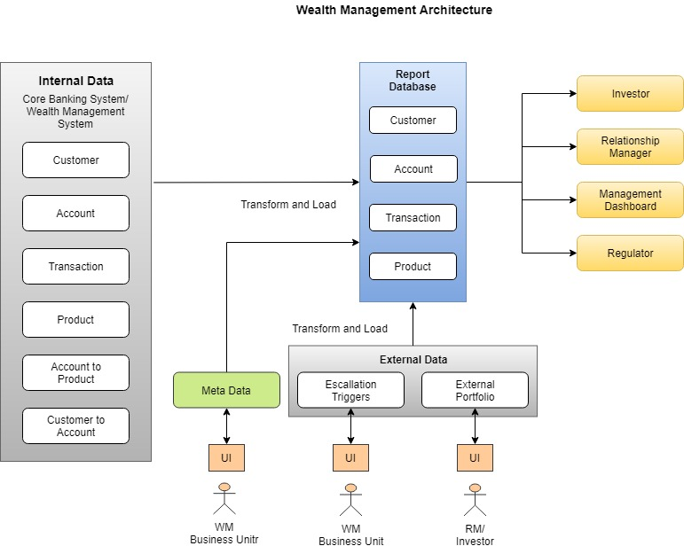
Wealth Management Analytics

Slide 4
Visualizations and interface for Customer
Portfolio with Amount Invested, Current Market Value, Redemptions/ Payouts, IRR, Absolute Return, Future Value, Standard Deviation or Risk Adjusted Return of portfolio and by fund. With benchmark return.
Weighted Risk break-up
Break-up by Fund, Instrument Type, Suggested break-up based on risk profile.
Suggested instruments – Cluster Analysis, Recommendation Engine Results.
Transaction frequency, expenses

Slide 5
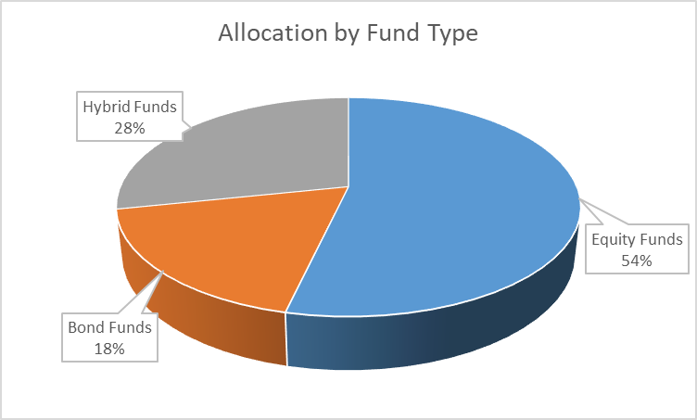
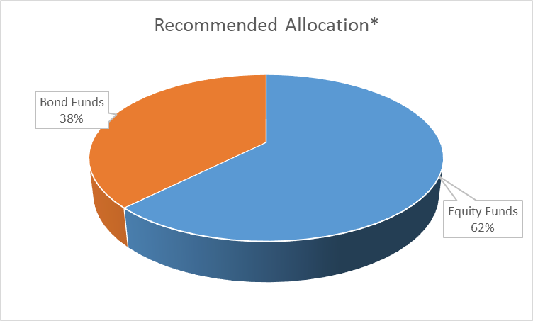
Visualizations for Investor

Slide 6
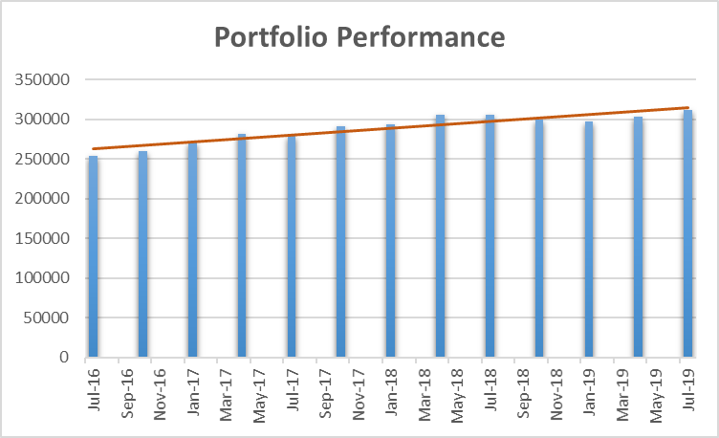
Visualizations for Investor

Slide 7
Visualizations and interface for Relationship Manager/ Customer Service
Number and value of Buy and Sell Transactions, by instrument type and instrument.
Concentration Risk – By customer and by transaction.
Customer Insights
- Attrition Score
- Recommendation Engine Score

Slide 8
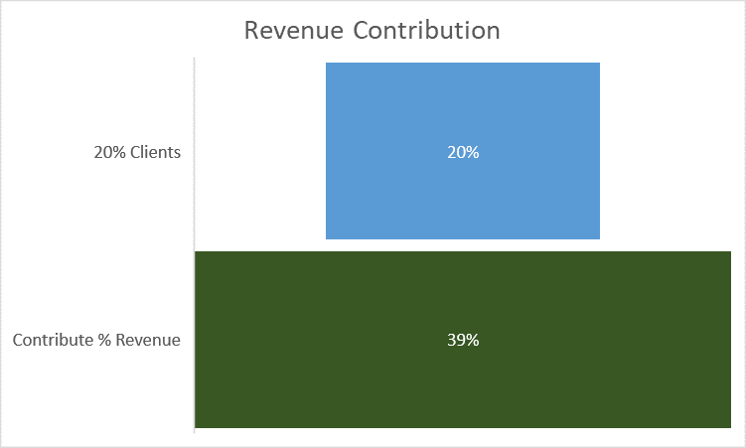
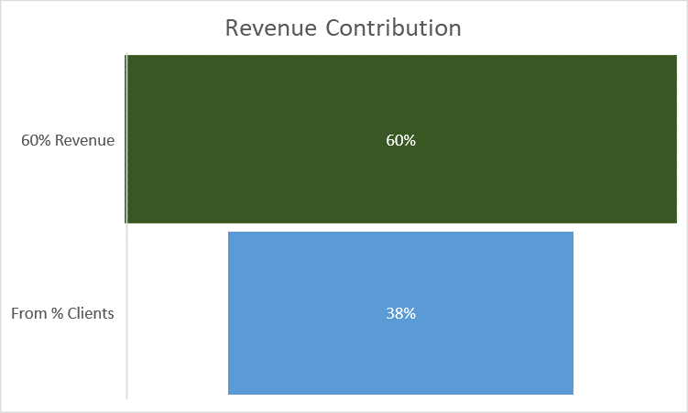
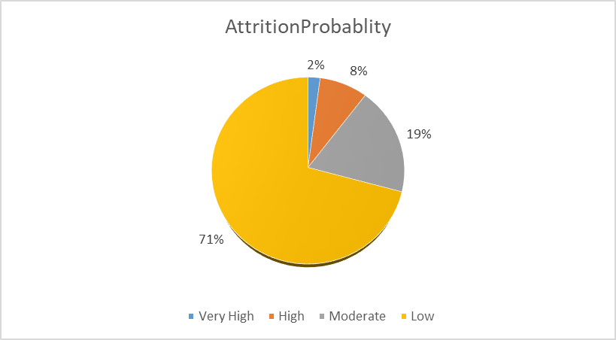
Visualizations for Relationship Managers and Customer Service

Slide 9
Visualizations and interface for Relationship Manager/ Customer Service Extracts
Number and value of Buy and Sell Transactions, by instrument type and instrument.
Concentration Risk – By customer and by transaction.
Customer Insights
- Attrition Score
- Recommendation Engine Score

Slide 10
Management Dashboards
Performance by RM, Branch, Region – Revenue, Assets Managed, %Growth in Assets.
Concentration Risk

Slide 11
Extracts
By instrument, Assets, Attrition Score

Slide 12
